Slide 1
JUnit

Slide 2
Course Objective
To understand and execute test using Junit
- Junit API
- Junit Annotations
- Assert classes

Slide 3
Unit Testing

Slide 4
Unit Testing
What is Unit Testing?
Unit Testing is a level of the software testing process where individual units/components of a software/system are tested.
The purpose is to validate that each unit of the software performs as designed.
A unit of work can span a single method, a whole class or multiple classes working together to achieve one single logical purpose that can be verified.
Unit Testing is normally performed by software developers

Slide 5
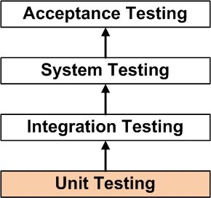
Unit Testing Hierarchy
The percentage of code which is tested by unit tests is typically called test coverage.
Layers in testing

Slide 6
Good Unit Test
Characteristics of good unit test
Able to be fully automated
Good Coverage
Can be run in any order if part of many other tests
Readable
Maintainable
Consistently returns the same result
Runs in memory

Slide 7
Unit Testing Frameworks
There are several testing frameworks available for Java.
Jtest
JUnit
JWalk
Cactus
TestNG
EasyMock
JMock
Mockito
The most popular ones are Junit and TestNG.

Slide 8
JUnit

Slide 9
Junit - Introduction
What is Junit?
JUnit is a simple open source Java testing framework used to write and run repeatable automated tests.
It’s a regression testing framework written by Erich Gamma and Kent Beck.
Runs a bunch of tests and reports their results.
Notes:
Regression testing is a type of software testingwhich verifies that software which was previously developed and tested still performs the same way after it was changed or interfaced with other software. Changes may include software enhancements, patches, configuration changes, etc

Slide 10
Features of JUnit
Assertions for testing expected results.
Test fixtures for sharing common test data.
Test suites for easily organizing and running tests.
Provides Annotation to identify the test methods
Notes:
An assertion is a boolean expression at a specific point in a program which will be true unless there is a bug in the program. A test assertion is defined as an expression, which encapsulates some testable logic specified about a target under test.
Fixtures is a fixed state of a set of objects used as a baseline for running tests. The purpose of a test fixture is to ensure that there is a well-known and fixed environment in which tests are run so that results are repeatable. It includes −
setUp() method, which runs before every test invocation.
tearDown() method, which runs after every test method.
A test suite bundles a few unit test cases and runs them together. In JUnit, both @RunWith and @Suite annotation are used to run the suite test

Slide 11
Environment Setup
JUnit is a framework for Java, so the very first requirement is to have JDK installed in your machine.
JDK | 1.5 or above.
Junit Jar | junit4.11.jar
hamcrest-core jar | hamcrest-core-1.3.jar

Slide 12
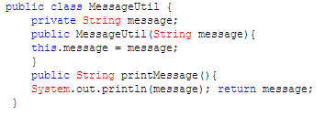
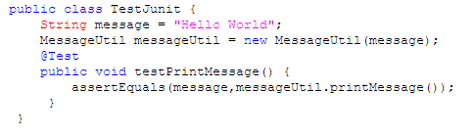
Basic Sample
Sample Program
Test Case Class

Slide 13
Coding Convention for Junit class
Name of the test class must end with “Test”
Name of the method must begin with “test”
Return type of a test method must be void
Test method must not throw any exception
Test method must not have any parameter

Slide 14
JUnit Api
The most important package in JUnit is junit.framework which contain all the core classes
Class Name | Functionality
Assert | A set of assert methods.
TestCase | A test case defines the fixture to run multiple tests.
TestResult | A TestResult collects the results of executing a test case.
TestSuite | A TestSuite is a Composite of Tests.
Test Runner | A Test runner is an executable program that runs tests
Notes:
Assert: This class provides a set of assertion methods useful for writing tests. Only failed assertions are recorded.
TestCase:A test case defines the fixture to run multiple tests.
void setUp()
Sets up the fixture, for example, open a network connection.
void tearDown()
Tears down the fixture, for example, close a network connection.
TestResult:
A TestResult collects the results of executing a test case. The test framework distinguishes between failures and errors. A failure is anticipated and checked for with assertions.
void addError(Test test, Throwable t)
Adds an error to the list of errors.
void addFailure(Test test, AssertionFailedError t)
Adds a failure to the list of failures.
Test Suite: A TestSuite is a Composite of tests. It runs a collection of test cases.

Slide 15
JUnit - Annotations Cont…
Every time we run a JUnit test class, a new instance of it is created. JUnit framework provides basic lifecycle annotations
@BeforeClass:
This method is called only once, whereas, other instance lifecycle methods are called every time before calling each test method.
This annotation is useful for initializing static resources which would, otherwise, be expensive to create during each test invocation
@AfterClass:
Similar to @BeforeClass but is called at the very end of all test/other lifecycle methods.
It is called only once. Useful for static resource clean up.

Slide 16
JUnit - Annotations Cont…
@Before:
It is invoked every time before each test method invocation.
Used to setup instance variables/resources which can be used during a test method execution.
@After:
Similar to @Before but runs after target test method execution.
Useful for cleaning up instance resources.

Slide 17
JUnit - Annotations Cont…
@Test:
Perform one or more assertions by using static methods of org.junit.Assert.
Assert methods throw org.junit.AssertionError on assertion failure.
This exception or any other exception is reported as test failure. If no exceptions are thrown then the test will pass.

Slide 18
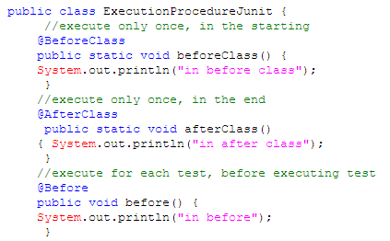
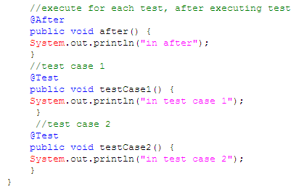
Annotations - Sample Demo

Slide 19
Assert Methods
S.No. | Method | Description
1. | void assertEquals(boolean expected, boolean actual) | It checks whether two values are equals similar to equals method of Object class
2. | void assertFalse(boolean condition) | functionality is to check that a condition is false.
3. | void assertNotNull(Object object) | "assertNotNull" functionality is to check that an object is not null.
4. | void assertNull(Object object) | "assertNull" functionality is to check that an object is null.
5. | void assertTrue(boolean condition) | "assertTrue" functionality is to check that a condition is true.
6. | void fail() | If you want to throw any assertion error, you have fail() that always results in a fail verdict.
7. | void assertSame([String message] | "assertSame" functionality is to check that the two objects refer to the same object.
8. | void assertNotSame([String message] | "assertNotSame" functionality is to check that the two objects do not refer to the same object.

Slide 20
Junit – Sample code Cont…
Steps to create Junit Test case
STEP1 :Create a Maven project
STEP2:Create a Java class
public class Addition {
public int add(int a,int b){
return (a+b);
}
}

Slide 21
Junit – Sample code Cont…
STEP 3:Test location
src/main/java - for Java classes
src/test/java - for test classes

Slide 22
Junit – Sample code Cont…
STEP 4: Create a Test class with Test method
public class AdditionTest {
private Addition addition;
/** * Initialization */
@Before
public void setUp() {
addition = new Addition();
}
/** * Test case for add method */
@Test
public void test() {
int i = addition.add(3, 7);
assert Equals(10, i);
}
/** * destroy the object */
@After
public void tearDown() {
addition = null;
}
}

Slide 23
Junit – Sample code Cont…
STEP 5:Add the following dependencies in POM.XML
<dependencies>
<dependency>
<groupId>junit</groupId>
<artifactId>junit</artifactId>
<version>4.12</version>
<scope>test</scope>
<exclusions>
<exclusion>
<groupId>org.hamcrest</groupId>
<artifactId>hamcrest-core</artifactId>
</exclusion>
</exclusions>
</dependency>

Slide 24
Junit – Sample code Cont…
<!-- This will get hamcrest-core automatically -->
<dependency>
<groupId>org.hamcrest</groupId>
<artifactId>hamcrest-library</artifactId>
<version>1.3</version>
<scope>test</scope>
</dependency>
</dependencies>

Slide 25
Junit – Sample code
STEP 6:Execute the junit test
Right click(project) -> Run AS -> Junit Test

Slide 26
Summary
A unit test targets a small unit of code, e.g., a method or a class.
An integration test aims to test the behavior of a component or the integration between a set of components.
Performance tests are used to benchmark software components repeatedly. Their purpose is to ensure that the code under test runs fast enough even if it’s under high load
test automation is the use of special software to control the execution of tests and the comparison of actual outcomes with predicted outcomes

